Slide 1



Marvel vs DC
View in Power BI
Last data refresh:
8/8/2024 4:54:25 PM UTC
Downloaded at:
1/29/2025 2:09:43 PM UTC

Slide 2
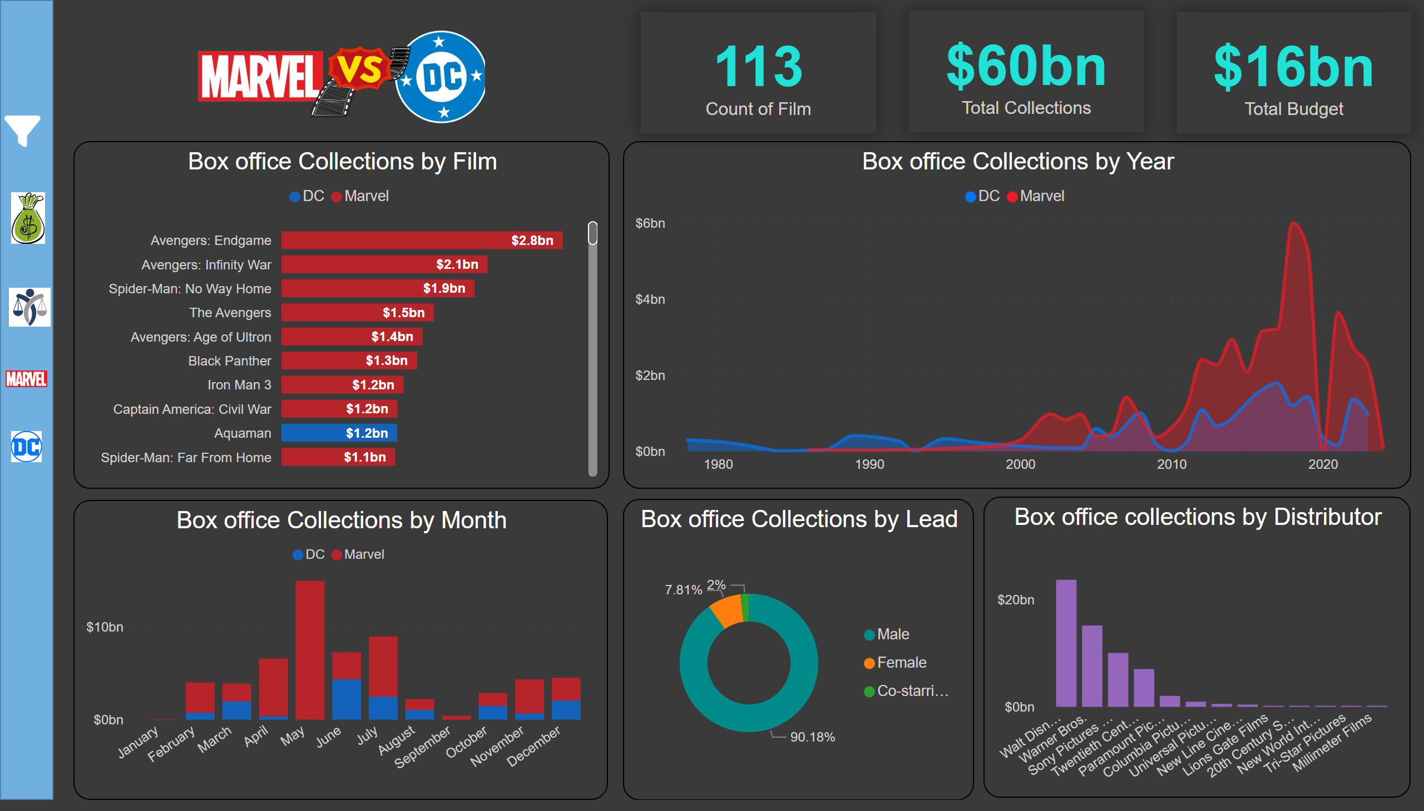
Marvel vs DC
Notes:
Box office Collections by Film
No alt text provided
Box office collections by Distributor
No alt text provided
Left Nav Background
No alt text provided
Filter Button
No alt text provided
actionButton
No alt text provided
advancedSlicerVisual
No alt text provided
advancedSlicerVisual
No alt text provided
advancedSlicerVisual
No alt text provided
shape
No alt text provided
Box office Collections by Year
No alt text provided
Box office Collections by Month
No alt text provided
Box office Collections by Lead
No alt text provided
card
No alt text provided
card
No alt text provided
image
No alt text provided
card
No alt text provided
image
No alt text provided
image
No alt text provided
image
No alt text provided
image
No alt text provided

Slide 3
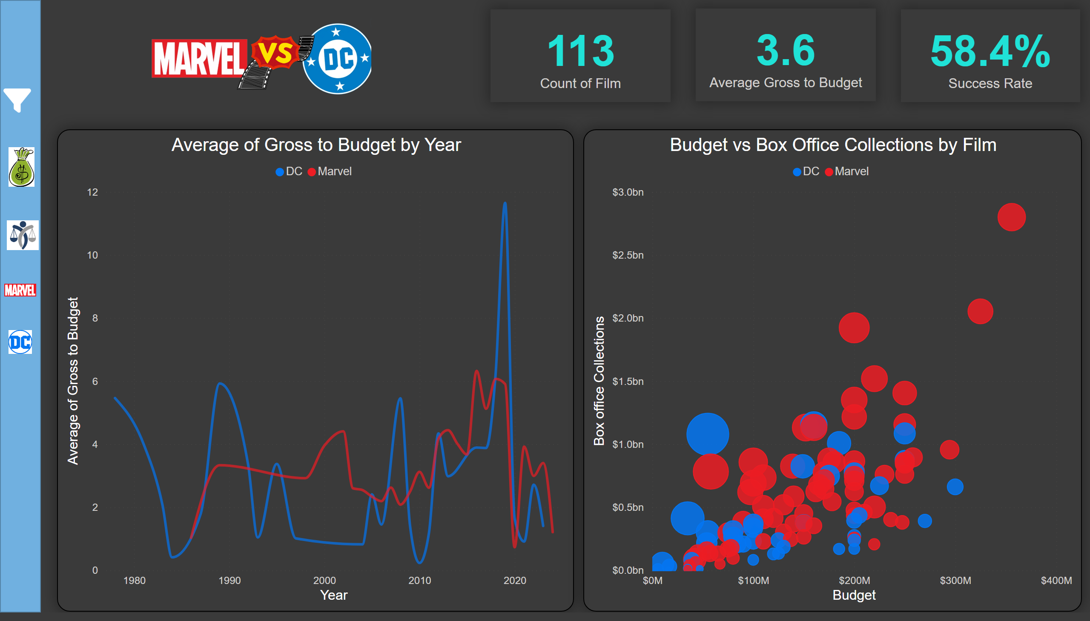
Gross to Budget
Notes:
Average of Gross to Budget by Year
No alt text provided
Filter Button
No alt text provided
Left Nav Background
No alt text provided
Budget vs Box Office Collections by Film
No alt text provided
actionButton
No alt text provided
slicer
No alt text provided
advancedSlicerVisual
No alt text provided
advancedSlicerVisual
No alt text provided
shape
No alt text provided
card
No alt text provided
image
No alt text provided
card
No alt text provided
card
No alt text provided
image
No alt text provided
image
No alt text provided
image
No alt text provided
image
No alt text provided

Slide 4
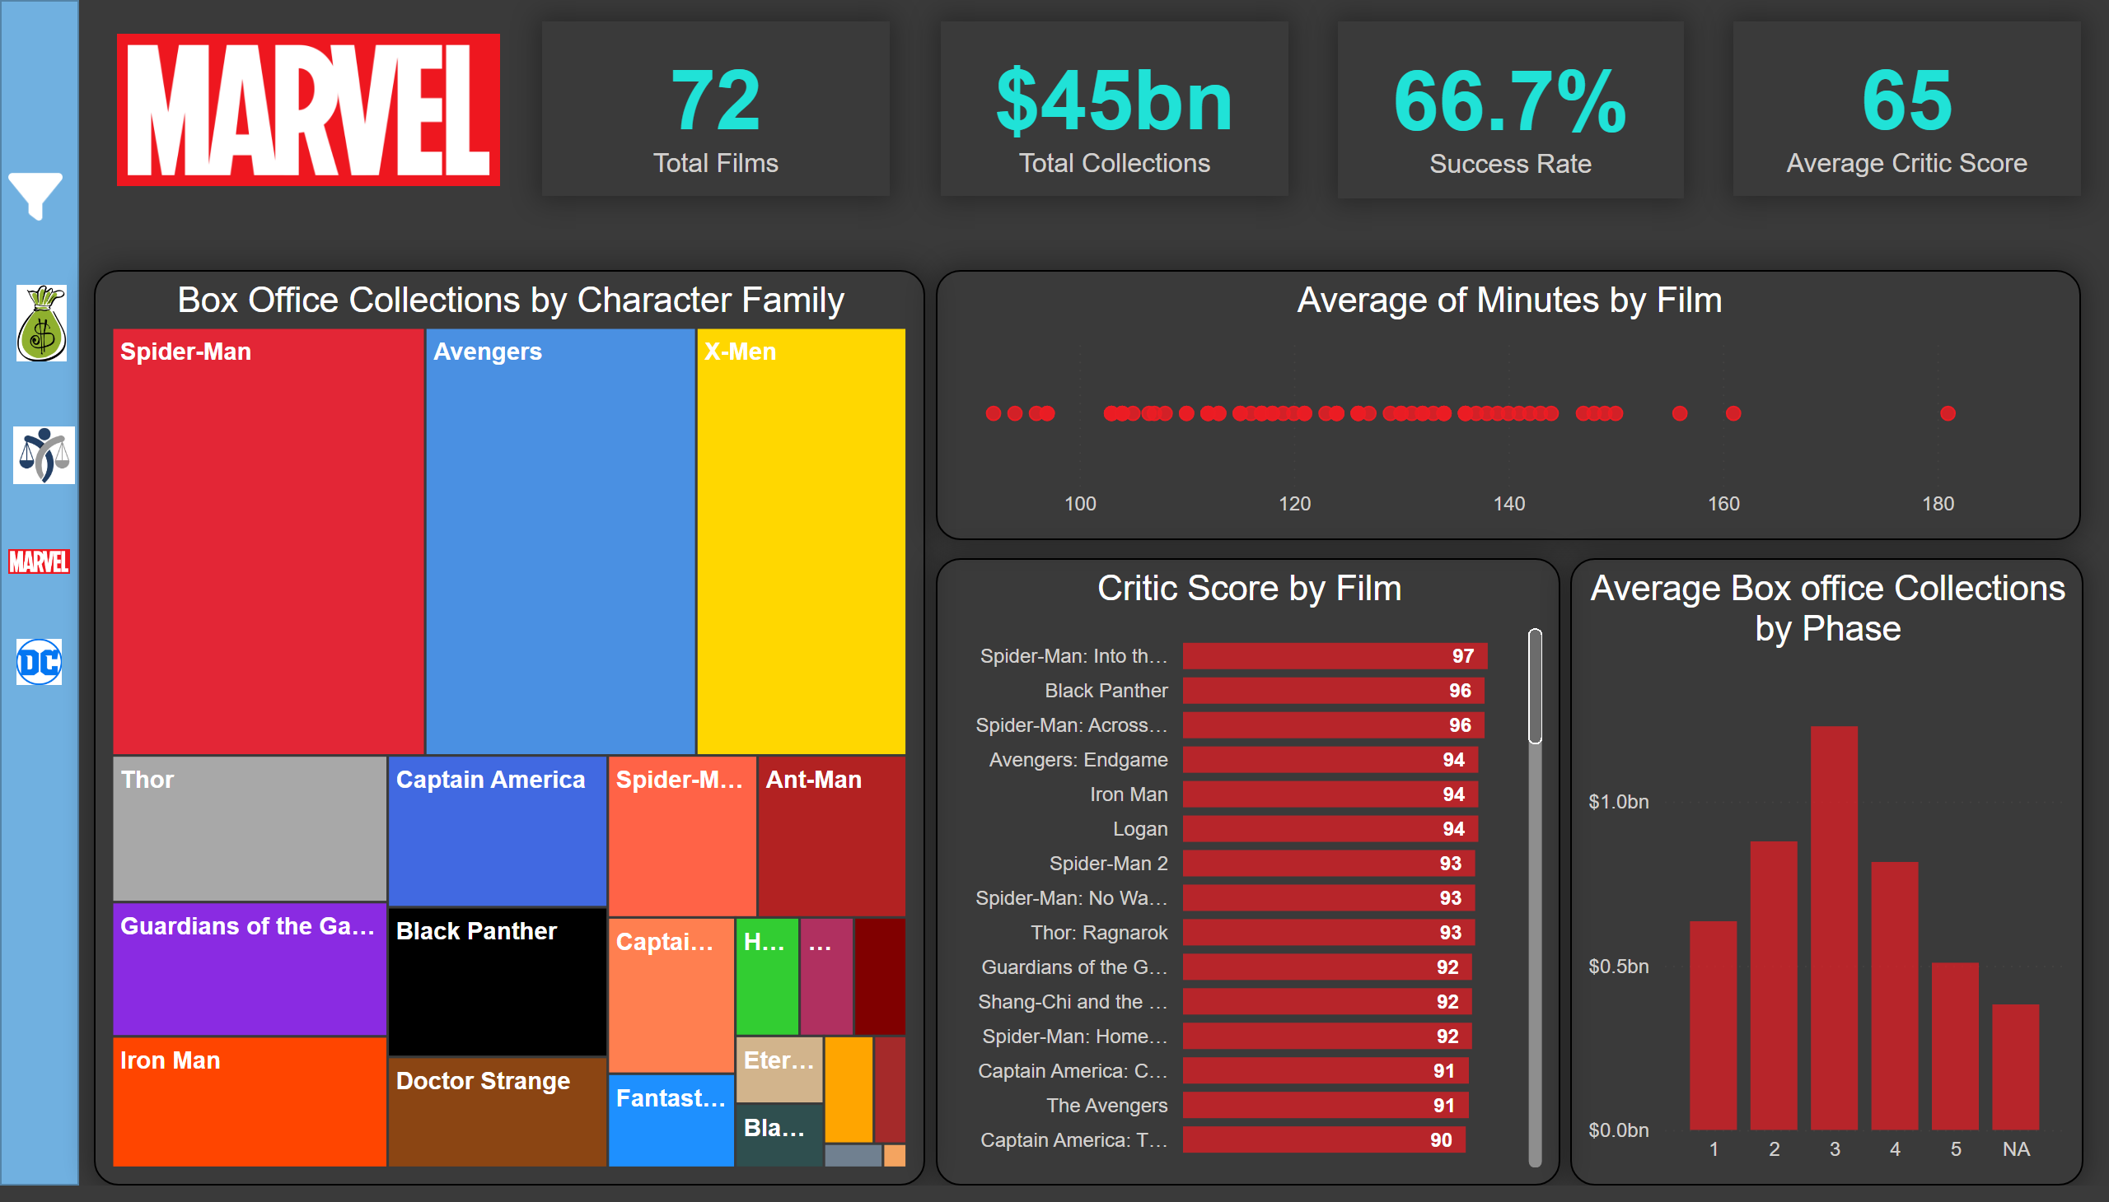
Marvel
Notes:
Average Box office Collections by Phase
No alt text provided
card
No alt text provided
card
No alt text provided
card
No alt text provided
Left Nav Background
No alt text provided
Critic Score by Film
No alt text provided
Box Office Collections by Character Family
No alt text provided
scatterChart
No alt text provided
card
No alt text provided
Filter Button
No alt text provided
actionButton
No alt text provided
advancedSlicerVisual
No alt text provided
advancedSlicerVisual
No alt text provided
shape
No alt text provided
slicer
No alt text provided
image
No alt text provided
image
No alt text provided
image
No alt text provided
image
No alt text provided
image
No alt text provided

Slide 5
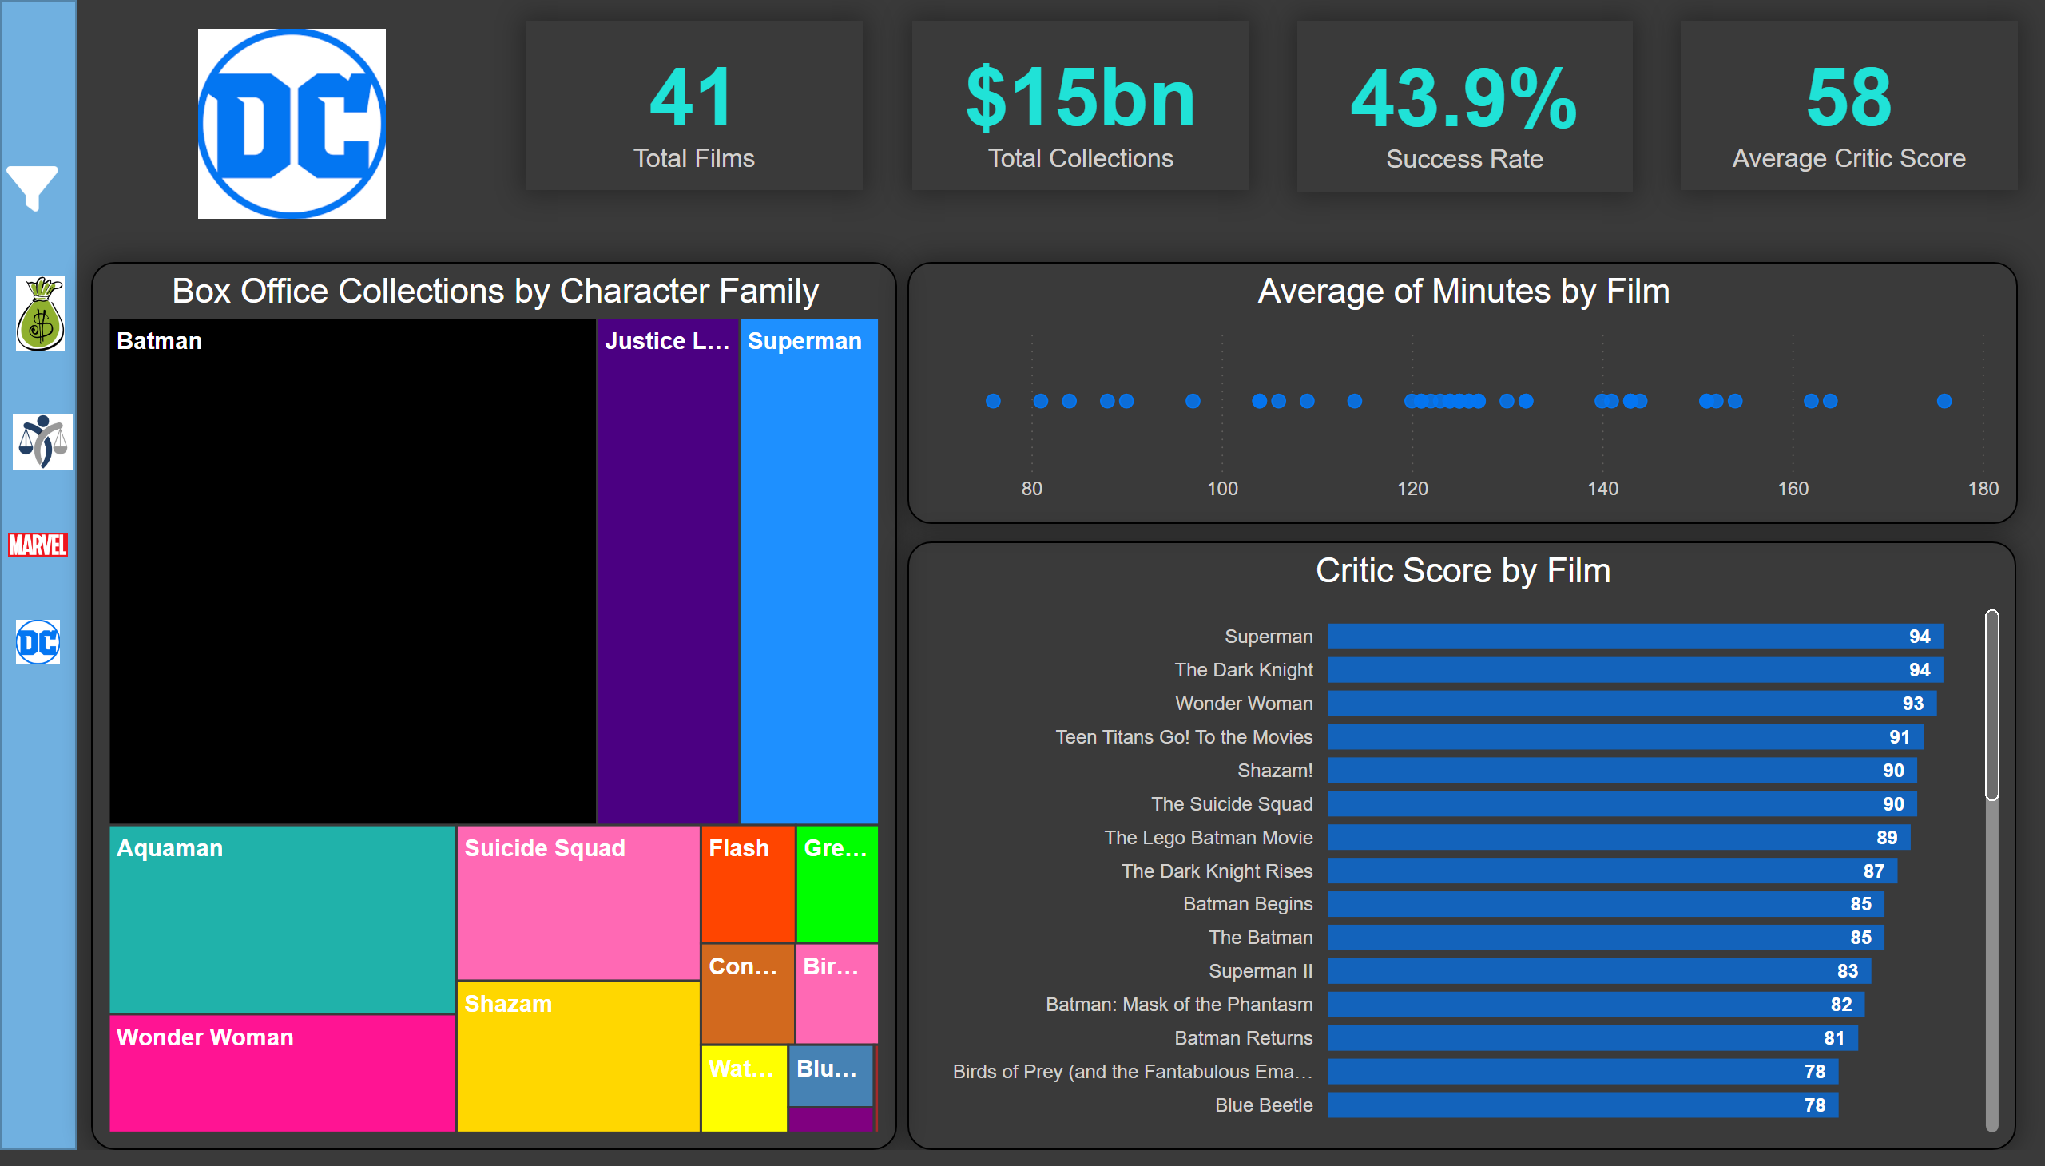
DC
Notes:
Left Nav Background
No alt text provided
scatterChart
No alt text provided
Box Office Collections by Character Family
No alt text provided
Critic Score by Film
No alt text provided
card
No alt text provided
card
No alt text provided
card
No alt text provided
card
No alt text provided
Filter Button
No alt text provided
actionButton
No alt text provided
advancedSlicerVisual
No alt text provided
advancedSlicerVisual
No alt text provided
shape
No alt text provided
slicer
No alt text provided
image
No alt text provided
image
No alt text provided
image
No alt text provided
image
No alt text provided
image
No alt text provided

